Slide 1
R Introduction

Slide 2
R is a comprehensive statistical and graphical programming language and is a dialect of the S language:
1988 - S2: RA Becker, JM Chambers, A Wilks
1992 - S3: JM Chambers, TJ Hastie
1998 - S4: JM Chambers
R: initially written by Ross Ihaka and Robert Gentleman at Dep. of Statistics of U of Auckland, New Zealand during 1990s.
Since 1997: international “R-core” team of 15 people with access to common CVS archive.

Slide 3
Getting Started
Where to get R?
Go to www.r-project.org
Downloads: CRAN
Set your Mirror: Anyone in the India is fine.
Select Windows 95 or later.
Select base.
Select R-2.4.1-win32.exe
The others are if you are a developer and wish to change the source code.
And then download R Studio

Slide 4
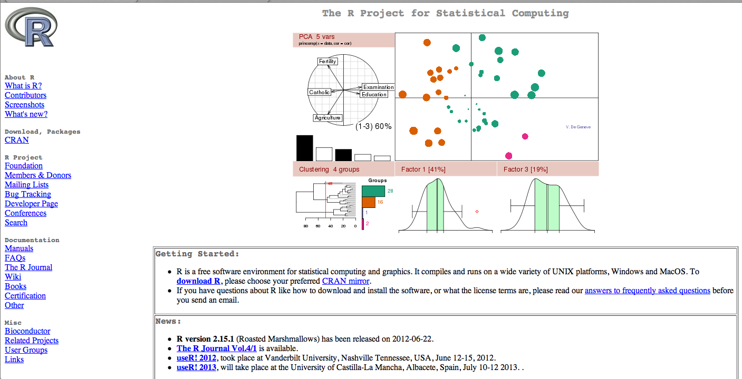
Getting Started
To install R on your MAC or PC you first need to go to http://www.r-project.org/.

Slide 5
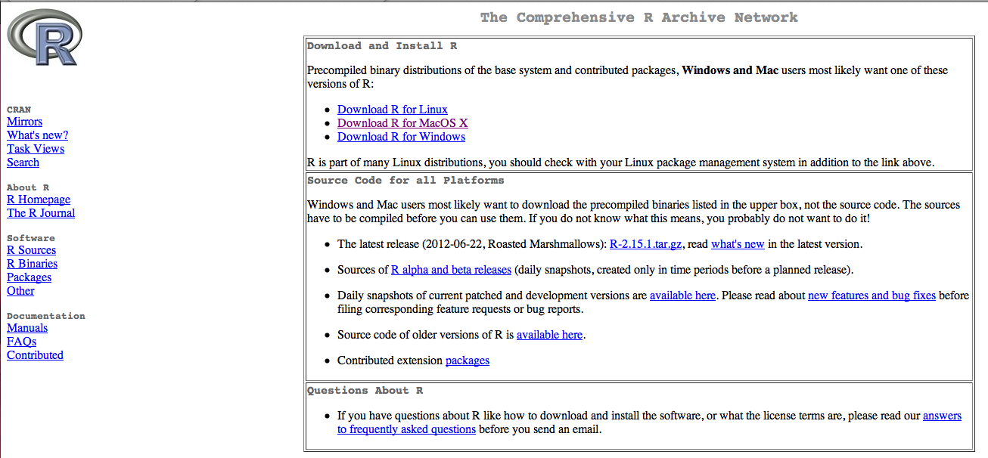
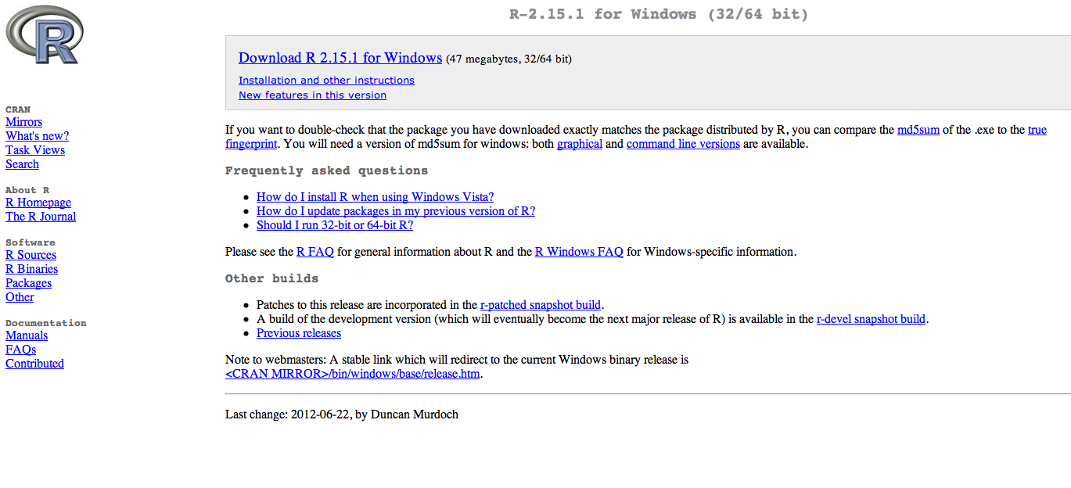
Notes:
Depending on if you are downloading for Windows or Mac click on your perspective thing…
Here we are going to go over windows so click on Download R for Windows
Then click download R

Slide 6
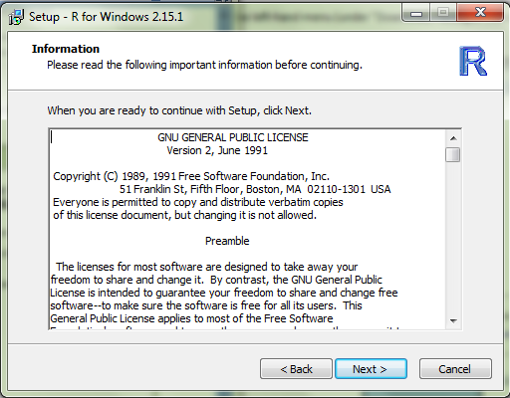
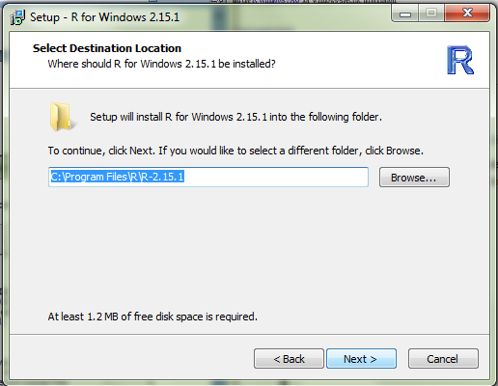
Notes:
This is the next screen that you will come to. Read the information and click next.
This is also where you need to set up you working directory…basically where you files are going to end up
Click where you want to put the file. This would be where if you wanted to put R on a flashdrive. Once you decide Click next.

Slide 7
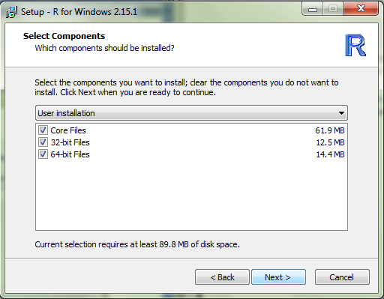
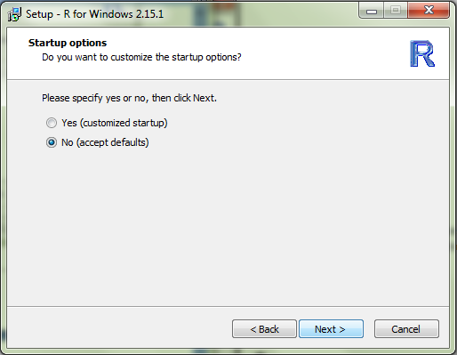
Notes:
Its always a good idea to download all the files.
MDI is when the windows will be contained within one large window. This is similar to how Excel is setup. SDI is a single document interface where every item will get its own window. This is similar to how SPSS is set up where it has separate data editor, viewer, and syntax windows. Once you choose which your prefer click next.

Slide 8
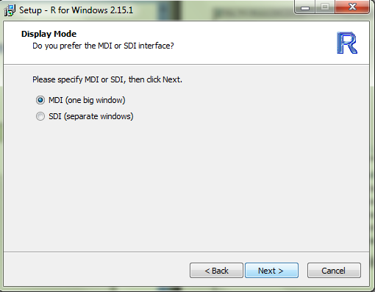
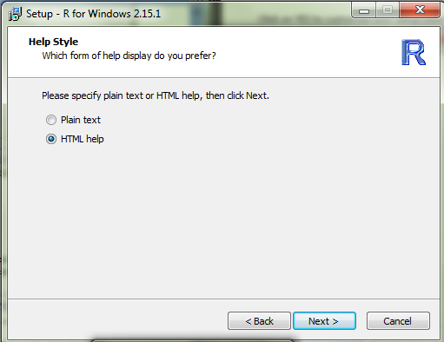

Slide 9
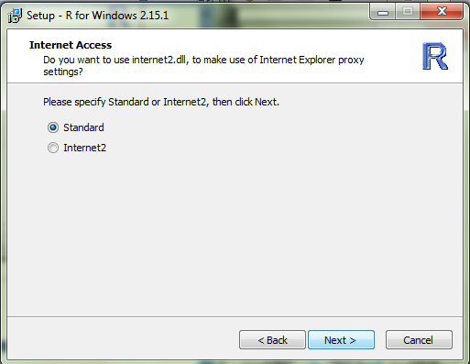
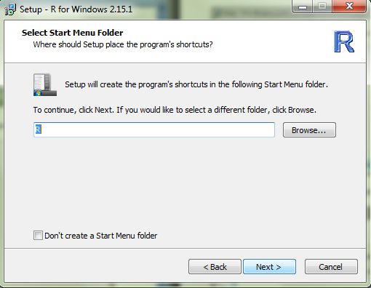
Notes:
Choose either html or plain text. Again, click next.
If you are installing R onto a flash drive click on Don’t create a start menu folder. Otherwise, you can leave it unchecked. Then click next.

Slide 10
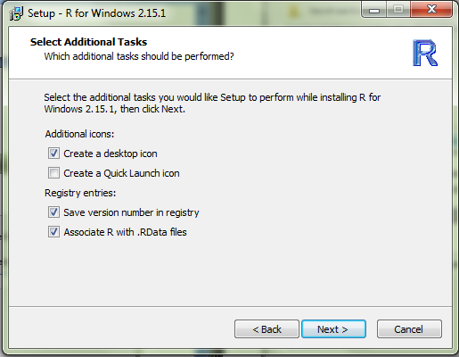
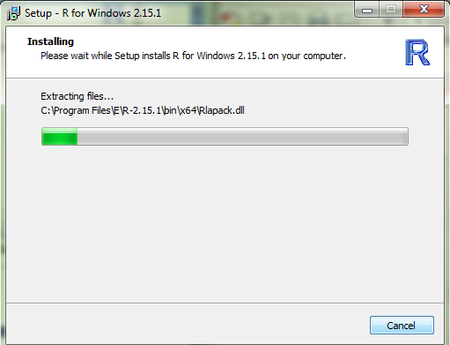
Notes:
Click next
The installation may take awhile

Slide 11
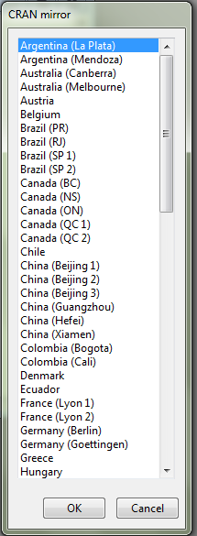
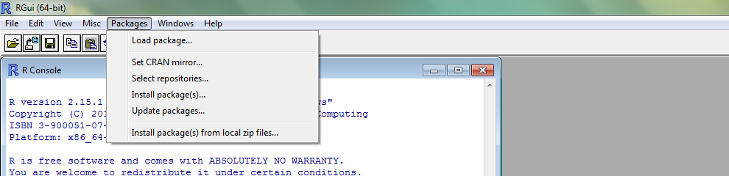
Installing Packages
Notes:
To install packages on Windows, click on packages and install packages.
Scroll down to USA and choose a “mirror” that is close to your physical location.

Slide 12
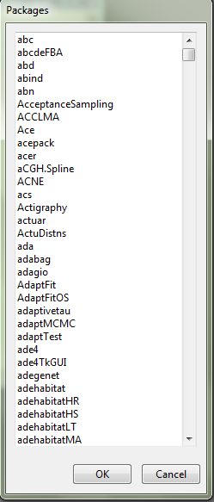
Notes:
Scroll down list until you find the package you are looking for. Keep in mind that R lists things in alphabetical order and by uppercase than lowercase. Once you click on a package to load, click ok. R will install not only the package but all of the packages needed to run your package.
To actually use the package, go back to the package tab and click on load package.

Slide 13
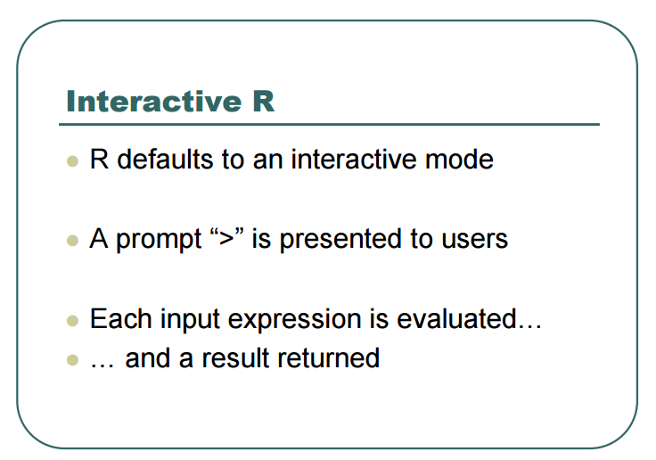

Slide 14
Operation Symbols
Symbol | Meaning
+ | Addition
- | Subtraction
* | Multiplication
/ | Division
%% | Modulo (estimates remainder in a division)
^ | Exponential

Slide 15
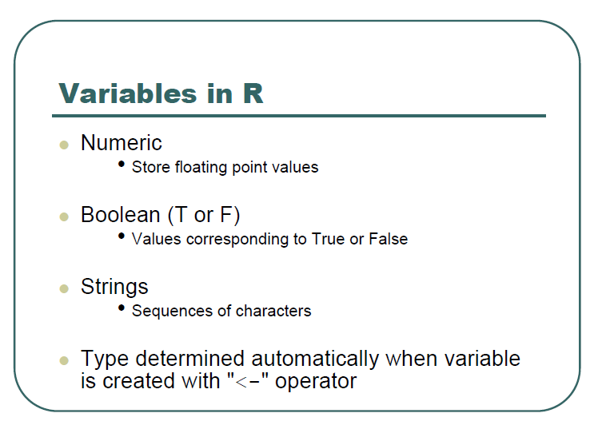

Slide 16
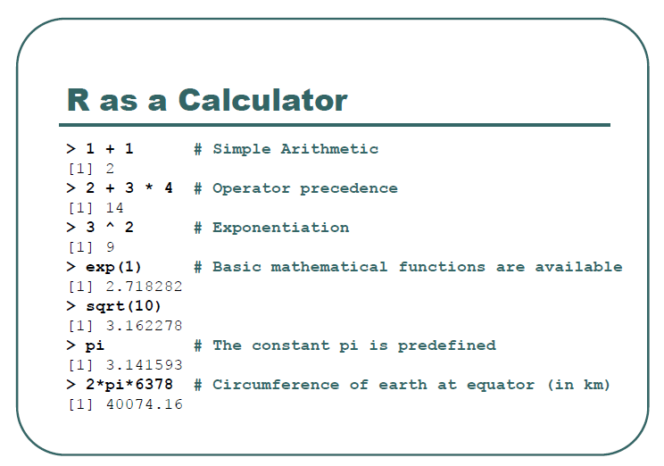
Notes:
To the minimum R can be used as a calculator.
The prompt sign means the active line where you are allowed to enter code.
The number in brackets is the result.
When you enter a line in R, you don’t need to end it with a period as opposed to other software such as the syntax in spss.

Slide 17
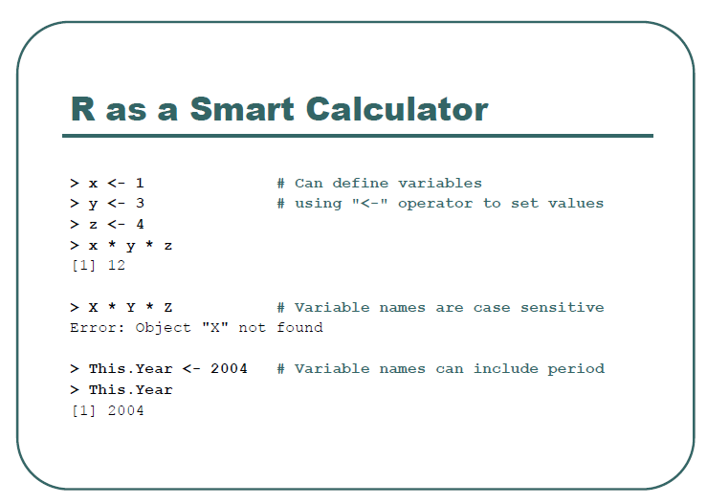

Slide 18
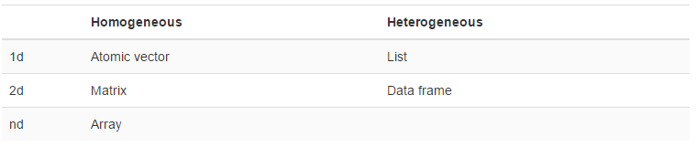
R data Structures
Vectors introduces you to atomic vectors and lists, R’s 1d data structures.
Attributes takes a small detour to discuss attributes, R’s flexible metadata specification. Here you’ll learn about factors, an important data structure created by setting attributes of an atomic vector.
Matrices and arrays introduces matrices and arrays, data structures for storing 2d and higher dimensional data.
Data frames teaches you about the data frame, the most important data structure for storing data in R. Data frames combine the behaviour of lists and matrices to make a structure ideally suited for the needs of statistical data
Notes:
You will learn later that dataframes can be imported from other statistical packages such as Excel and Spss.
However, knowing the basics on how R reads dataframes will help you manipulate your own data better in this package.

Slide 19
Vectors
Atomic vectors are usually created with c(), short for combine:
dbl_var <- c(1, 2.5, 4.5)

Slide 20
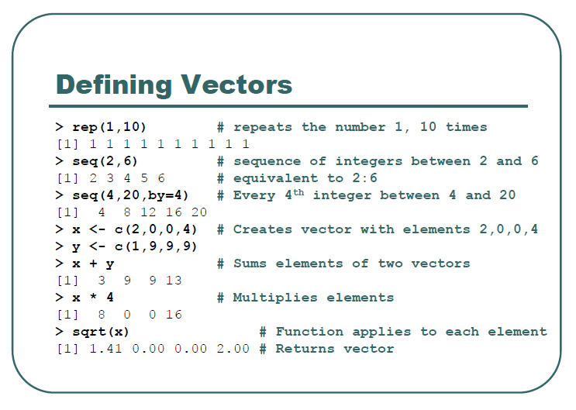

Slide 21
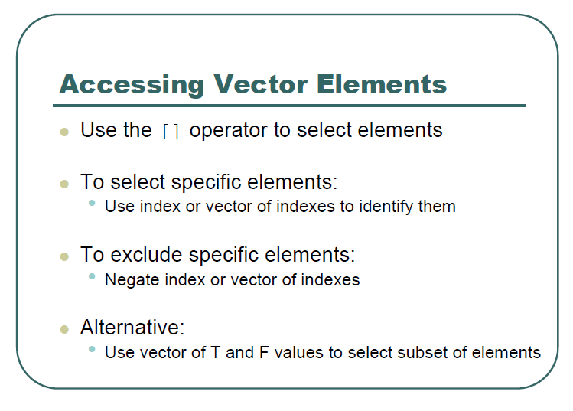

Slide 22
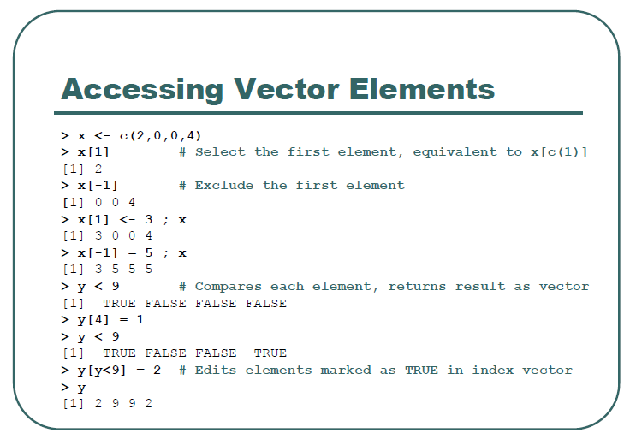

Slide 23
Matrices
Adding a dim() attribute to an atomic vector allows it to behave like a multi-dimensional array. A special case of the array is the matrix, which has two dimensions. Matrices are used commonly as part of the mathematical machinery of statistics. Arrays are much rarer, but worth being aware of.
# Two scalar arguments to specify rows and columns
a <- matrix(1:6, ncol = 3, nrow = 2)
# One vector argument to describe all dimensions
b <- array(1:12, c(2, 3, 2))
# You can also modify an object in place by setting dim()
c <- 1:6
dim(c) <- c(3, 2)
dim(c) <- c(2, 3)

Slide 24
Data frames
A data frame is the most common way of storing data in R, and if used systematically makes data analysis easier. Under the hood, a data frame is a list of equal-length vectors. This makes it a 2-dimensional structure, so it shares properties of both the matrix and the list. This means that a data frame has names(), colnames(), and rownames(), although names() and colnames() are the same thing. The length() of a data frame is the length of the underlying list and so is the same as ncol(); nrow() gives the number of rows.
df <- data.frame(x = 1:3, y = c("a", "b", "c"))
data.frame(height=c(150,160),weight=c(65,72))

Slide 25
Factors
One important use of attributes is to define factors. A factor is a vector that can contain only predefined values, and is used to store categorical data
x <- factor(c("a", "b", "b", "a"))
class(x)
levels(x)
Notes:
In this slide. Go to R code and practice creating objects and vectors.

Slide 26
Lists
Lists are different from atomic vectors because their elements can be of any type, including lists. You construct lists by using list() instead of c():
x <- list(1:3, "a", c(TRUE, FALSE, TRUE), c(2.3, 5.9))
str(x)

Slide 27
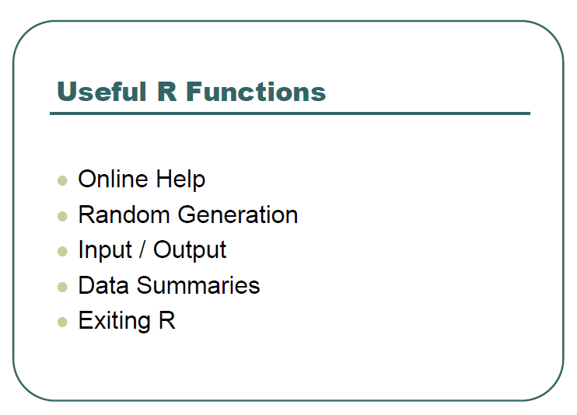
Notes:
In this slide. Go to R code and practice creating objects and vectors.

Slide 28
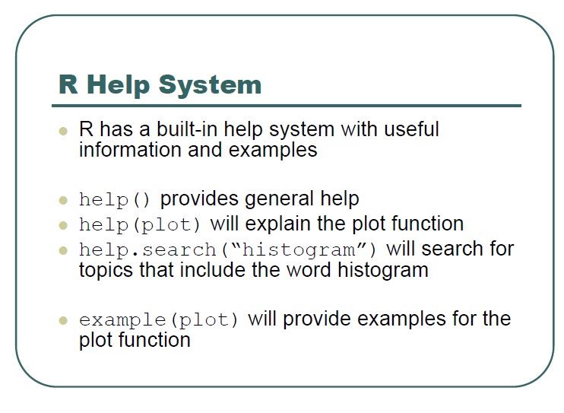
Notes:
In this slide. Go to R code and practice creating objects and vectors.

Slide 29
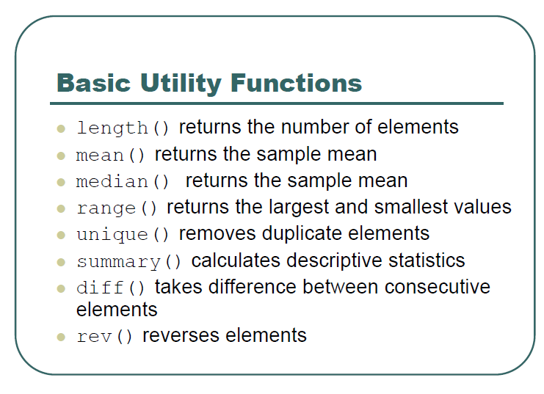
Notes:
In this slide. Go to R code and practice creating objects and vectors.

Slide 30
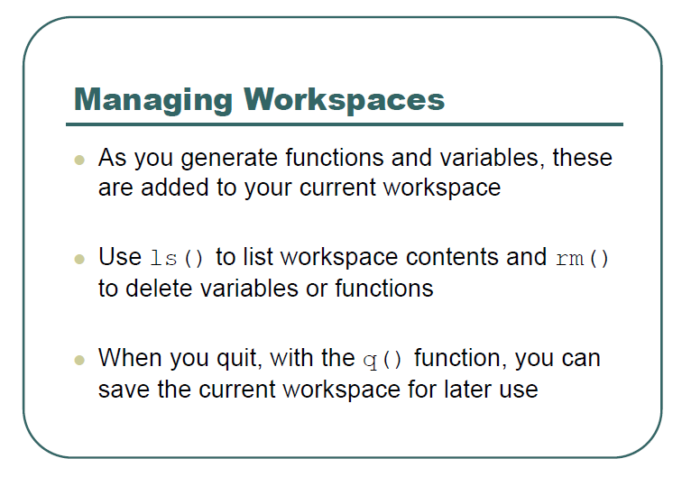
Notes:
In this slide. Go to R code and practice creating objects and vectors.

Slide 31
Thank You

